Slide 1


Trentino territory
Find all naturalistic point of interest inside of trentino
Ludovic CHEVALLIER and Andrea FRIGO
Notes:
The purpose of our project is the development of an application that provides natural places in function of their category, name or location. The application will provide some information as name, description, category, company, location. With the usage of third-party services, the application will also be capable of calculating a route to arrive at the attraction from the user's position. It will be possible to order the results by distance or name. The application will also suggest some interesting activities or places near the point of interest (for example a "malga" in the mountain where the user wants to hike).
Andrea

Slide 2


Inception phases ( Datasets & teologies)
Notes:
For the datasets we look for keywords like : POI(point of interest), luoghi e punti di interesse or by categories like (ambiente which regroup all the information about the territory). We tried to look in other web sites but we didn’t find any other useful information.
For shcema we used schema.org and extract all the onotologies linked to the schema PLACE. We didn’t look in other websites because it was already fine
Ludovic

Slide 3



Inception phases(CQ)
Get all the point of interest near from the customer
Get a point of interest based on its name
Get all the point of interest of a certain category
Notes:
Ludovic

Slide 4
Scenario | CQ | Kernel | Common | Core | Contextual
S1 | List of all naturalistic attractions in Trentino | attractions, name | name | attraction
 | Which are the attractions near my house? | attractions, location, latitude, longitude | location, latitude, longitude
 | Read a description of one specific attraction | description, attraction |  |  | description
S2 | Where is the specific attraction x? | attractions, address, province, city, CAP, street, street number, commune | address, province, city, street, street number, commune
 | How much time do I need to reach it? | location
S3 | When is the attraction open? | attraction schedule |  |  | schedule
 | What is the price? | price |  |  | price
 | Is there a web site? | web site |  |  | web site
 | Phone number for the attraction | phone number |  |  | phone number
 | Is there a parking area? | parking area |  |  | parking area
 | List of all places which are ski places | category | category
 | Which company owns the attraction? | company |  | company

Slide 5
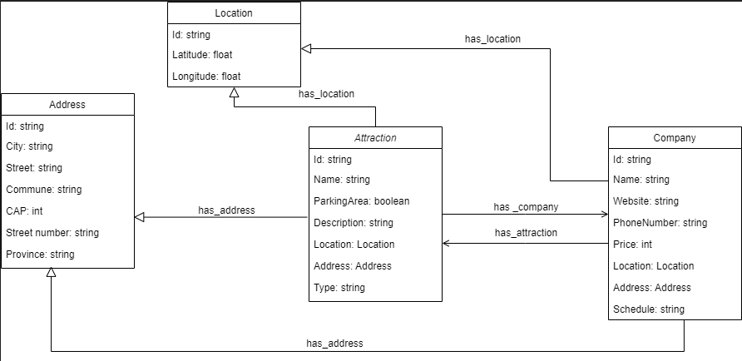
Informal modeling(ER model)
Specific information
Spatial information
Notes:
We splitted attraction and company because they are 2 differents etypes, and becuase for one company we can have multiple attraction. We splitted address and location because location will be used by a third service and address would be sue for the user interest.
Andrea

Slide 6
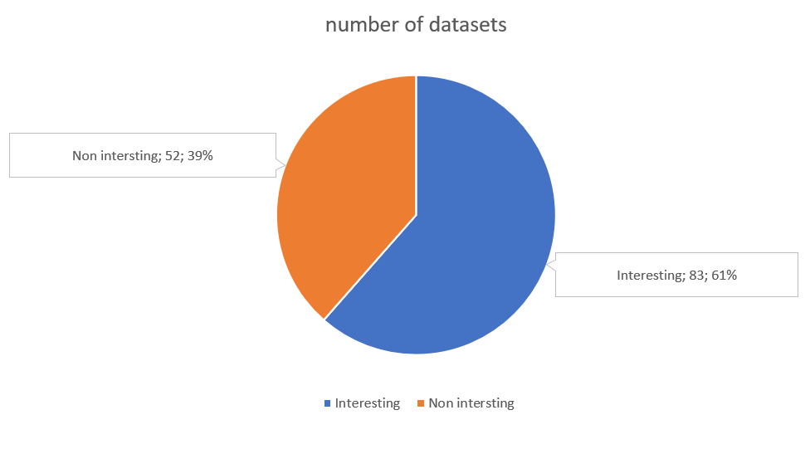
Informal modeling(selection CSV datasets)
Notes:
For the JSON datasets we kept only the "Trentino" one and not the "Valsugana", because we found out that the second is a subpart of the first and does not give any additional information.
Andrea

Slide 7
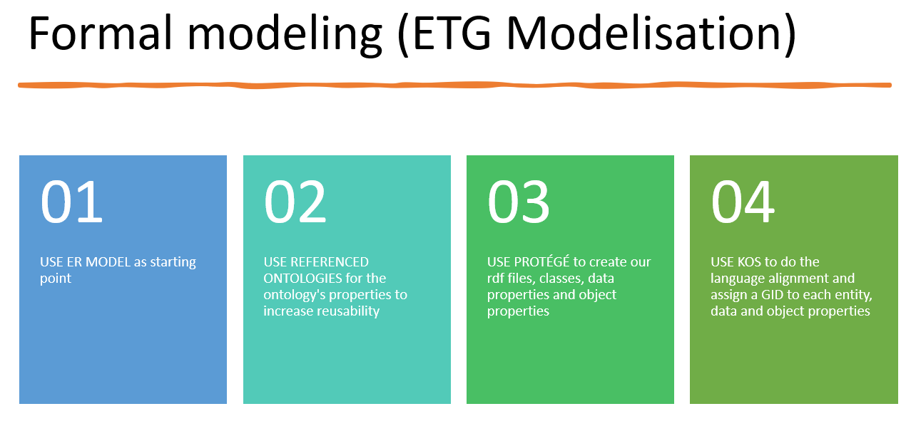
Notes:
Ludovic
non living being
create a new id for street number
Create a new class location and not use the already existing one

Slide 8
Formal modeling (Syntathic etherogenity)
Via roma,20, 38001,TR, trento
Bedollo.csv
Street name
Street number
Postal code
Province
City
Commune
Notes:
Ludovic
cast dataset: for all the value that must be integer convert into integer(Postal code), and floats (Price, latitude and longitude) and for strings we put “none”

Slide 9
Data Integration (Entity matching)
Attraction: check by names (jaro similarity), by coordinates (geo distances)
Location : coordinates
Address: all same value
Company: all same value
Notes:
Attraction =Ludovic

Slide 10
Data Integration(Semantic Heterogeneity)
ID | NAME | DESCRIPTION | PARKING AREA | TELEPHONE | LAT | CITY | STREET | STREET NUMBER
A1 | Disneyland | It’s cool and not cheap | true | 3334561234 | 42.43 | Verona | Via Roma
A2 | Disneyland © | It’s cool | false | 3204561234 | 42.43567 | Verona | Via Venezia | 20
ID | NAME | DESCRIPTION | PARKING AREA | TELEPHONE | LAT | CITY | STREET | STREET NUMBER
A1 | Disneyland | It’s cool and not cheap | true | 3334561234 3204561234 | 42.43567 | Verona | Via Venezia | 20
Notes:
Andrea

Slide 11


Slide 12


